Slide 1
Operating Systems & Final Project Overview
The Software Stack, Operating Systems Overview, Final Project Overview

Slide 2
Lecture Outline
The Software Stack
Roadmap of Hardware and Software Components
Operating Systems Overview
Abstraction, Protection, Processes, Virtual Memory
Final Project Overview
E-Portfolio Details and Presentation Logistics

Slide 3
Roadmap
SOFTWARE
HARDWARE
High-Level Language
Intermediate Language(s)
Assembly Language
Operating System
Machine Code
Computer
Memory
CPU
ALU
PC
Basic Logic Gates
NAND

Slide 4
Roadmap
SOFTWARE
HARDWARE
High-Level Language
Intermediate Language(s)
Assembly Language
Operating System
Machine Code
Computer
Memory
CPU
ALU
PC
Basic Logic Gates
NAND

Slide 5
Roadmap
SOFTWARE
HARDWARE
High-Level Language
Intermediate Language(s)
Assembly Language
Operating System
Assembler
Machine Code
Computer
Memory
CPU
ALU
PC
Basic Logic Gates
NAND

Slide 6
Roadmap
SOFTWARE
HARDWARE
High-Level Language
Focus for the rest of the course
Intermediate Language(s)
Assembly Language
Operating System
Assembler
Machine Code
Computer
Memory
CPU
ALU
PC
Basic Logic Gates
NAND

Slide 7
Roadmap
SOFTWARE
HARDWARE
High-Level Language
Focus for the rest of the course
Intermediate Language(s)
Assembly Language
Operating System
Focus for today
Assembler
Machine Code
Computer
Memory
CPU
ALU
PC
Basic Logic Gates
NAND
Notes:
Focus for the rest of the course. We talked about the assembler, we will learn more about the operating systems.
Won’t go as deep into each. Use it as a survey of some topics, lower-level computing topics. These are courses within the Allen School. Almost certainly in a class in the Allen School to learn more about that. Keep these things in mind.

Slide 8
Software
Overview
SOFTWARE
Java
Python
C/C++
Jack
High-Level Language
Compiler
Java Byte Code
Jack VM Code
Intermediate Language(s)
Compiler
(VM Translator)
x86, x86-64
ARM
RISC-V
HACK
Windows
macOS
Unix/Linux
Android
Hack OS
Assembly Language
Operating System
Assembler
Machine Code

Slide 9
Lecture Outline
The Software Stack
Roadmap of Hardware and Software Components
Operating Systems Overview
Abstraction, Protection, Processes, Virtual Memory
Final Project Overview
E-Portfolio Details and Presentation Logistics

Slide 10
The Operating System
The operating system (OS) is just another piece of software
A massive, complex piece of software
In the end, uses the same machine language your code does
Your Code
Operating System Code
(USERPROG1)
@R1
D=D+1
M=D
@R2
M=D+1
D=0
...
@OSRETURN1
0;JMP
@R0
D=M // Ask user what
@i // program to run
A=M+1
M=-D
@USERPROG1
D;JEQ
...
(OSRETURN1)
@R3
M=D+1
...

Slide 11
The Operating System
The operating system (OS) is just another piece of software
A massive, complex piece of software
In the end, uses the same machine language your code does
OS is more trusted than the rest of the software that runs on your computer
User programs and applications invoke (ask) the OS to perform operations they are not trusted or allowed to
Means the OS needs to be secure

Slide 12
Why an Operating System?
Directly interacts with the hardware
Benefit: Abstraction
Provides high-level functionality for messy hardware devices
OS must be ported to new hardware, but user-level programs can then be portable
Benefit: Protection
OS is trusted to touch hardware; user-level programs are not
User-level programs cannot “break things”
Maintains security between programs and user accounts

Slide 13
Operating System: Abstraction
Many abstractions provided by real-world operating systems
File System
File contents = just bits in the “giant array” that is the hard drive (“permanent” storage, as opposed to temporary storage in RAM that disappears when computer is turned off)
OS keeps a record of which ones fall into which “files”

Slide 14
Operating System: Abstraction
Many abstractions provided by real-world operating systems
Network Stack
Communicating with network devices ≈ communicating with screen/keyboard memory map
OS handles messy, time-sensitive protocols
Processes
Only one process can run at once on a CPU
OS switches very quickly, illusion of running both “at once”

Slide 15
Operating System: Protection
The CPU has different “privilege” levels when it is executing (controlled by a register on the CPU)
OS code and memory can only be executed by an OS privilege level
Your applications run at a lower level and cannot access OS code and memory
This prevents applications from crashing entire system
For example, if your web browser crashes, usually it doesn’t crash your entire computer
Also helpful for security purposes

Slide 16
Operating Systems: Protection
Example: Suppose we want only the OS to be allowed to run instruction SET_ON_FIRE
But if the OS is just a machine code program like any other… what’s the security hole?

Slide 17
Operating Systems: Protection
Example: Suppose we want only the OS to be allowed to run instruction SET_ON_FIRE
But if the OS is just a machine code program like any other… what’s the security hole?
Your Code
Operating System Code
(USERPROG1)
@R1
D=D+1
M=D
SET_ON_FIRE
M=D+1
D=0
...
@OSRETURN1
0;JMP
@R0
D=M // Ask user what
@i // program to run
A=M+1
M=-D
@USERPROG1
D;JEQ
...
(OSRETURN1)
@R3
M=D+1

Slide 18
Operating Systems: Protection
The fix: hardware bit for “privileged mode”
Processor checks before running SET_ON_FIRE
OS disables before jumping to user code, re-enables on return
(Processor also must check that user code can’t enable privilege)
Your Code
Operating System Code
(USERPROG1)
@R1
D=D+1
M=D
SET_ON_FIRE
M=D+1
D=0
...
@OSRETURN1
0;JMP
@R0
SET_ON_FIRE
D=M // Ask user what
@i // program to run
A=M+1
DISABLE_PRIVILEGE
@USERPROG1
D;JEQ
...
(OSRETURN1)
ENABLE_PRIVILEGE
@R3
M=D+1
HW Privilege Bit
1

Slide 19
Operating System: Processes
A “process” is an application running on your computer
E.g., your web browser, terminal, Microsoft Word, etc.
Each app instance contained in one or more processes
The OS manages these processes
Multiple processes are “running” at the same time, but it’s just the OS quickly switching between them
A process only has access to its memory, and cannot access the memory of other processes
This is helpful because if one process crashes or is malicious, it makes it more difficult to crash or corrupt other processes too

Slide 20
Why Not an Operating System?
The Hack computer we’ve built is… small
Uses the same principles as your laptop CPU
But in terms of scale, closer to a microprocessor or small embedded chip
For embedded systems, often an OS is overkill—instead, designed to be programmed with/run a single program at a time
Benefit: developer gets complete control over the device
Drawback: re-implement OS features, no protection

Slide 21

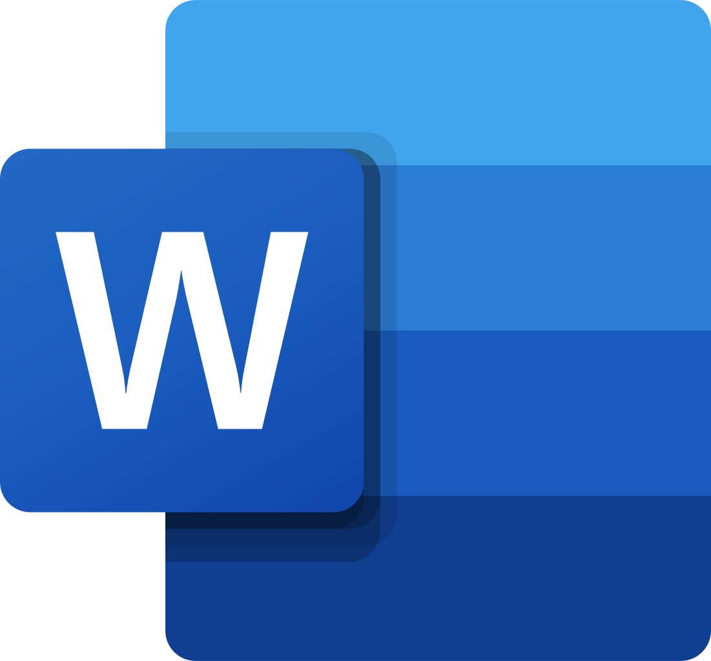
Virtual Memory
virtual registers, variables
stack
Most OS’s allow multiple processes, but shouldn’t be able to modify values in another’s address space
OS provides illusion of separate address spaces via virtual memory
Really all one physical memory
OS & hardware map pieces of virtual memory to pieces of physical memory
heap
screen memory map
keyboard memory map
virtual registers, variables
stack
heap
screen memory map
keyboard memory map

Slide 22
Virtual Memory
virtual registers, variables
stack
Benefit:
Security: programs only know about their own address space
Don’t even have a way to describe address of other application’s data
Drawback:
Efficiency: virtual address translation is fast nowadays but still slower than directly accessing memory (what microprocessors do)
heap
screen memory map
keyboard memory map
virtual registers, variables
stack
heap
screen memory map
keyboard memory map

Slide 23
Comparison of Operating Systems
Three different ways to do essentially the same thing
Everyone has their own preference
Each have their own benefits and tradeoffs
Work on varying types of hardware, provide different levels of customization, different features, work better with different software, open source vs. proprietary, etc.
You could choose to do some research next time you are deciding on a laptop, computer, or OS

Slide 24
Five-minute Break!
Feel free to stand up, stretch, use the restroom, drink some water, review your notes, or ask questions
We’ll be back at:
Research shows mid-lecture breaks reduce the decline of attention in the middle of lecture (Olmsted, 1999)
Olmsted III, John. “The Mid-Lecture Break: When Less Is More.” Journal of Chemical Education (1999). https://pubs.acs.org/doi/abs/10.1021/ed076p525.

Slide 25
Lecture Outline
The Software Stack
Roadmap of Hardware and Software Components
Operating Systems Overview
Abstraction, Protection, Processes, Virtual Memory
Final Project Overview
E-Portfolio Details and Presentation Logistics

Slide 26
Final Project E-Portfolio Overview
You will create an E-Portfolio that is geared toward a new Allen School student
Your E-Portfolio is a culminating project in having you reflect on the metacognitive skills you’ve learned and providing advice for entering the program
During our final class, you will give an 8–10-minute presentation on your E-Portfolio

Slide 27
Final Project E-Portfolio Components
Part I: Outline of E-Portfolio
Final project check-in and feedback during next Tuesday’s class
Due next Thursday (6/2) at 11:59pm PDT
Part II: Final E-Portfolio Submission
Due Tuesday of finals week (6/7) at 4:00pm PDT
Part III: E-Portfolio Presentations
During the scheduled CSE 390B final (Tuesday, 6/7 at 4:30pm PDT)
We’ll split up into small groups with your TA

Slide 28
Final Project Ideas Brainstorming
Brainstorm individually for five minutes:
Looking back on this quarter, what metacognitive skills impacted you the most?
What were some concrete examples of yourself demonstrating these metacognitive skills?
What was one technical topic from CSE 390B that helped you connect the dots?
Discuss in groups of 3-4 for five minutes

Slide 29
Lecture 17 Wrap-up
Thursday’s Lecture: Procrastination, Stress Response Cycle, & Computer Networks
Reading: Feminist Survival Project Episode 2
Upcoming Project Reminders
Project 7, Part II (Professor Meeting Report) due this Thursday (5/26) at 11:59pm PDT
Project 8 (Debugging & Implementing a Compiler) due next Tuesday (5/31) at 11:59pm PDT
Check Canvas for late updated late days through Project 5

